Slide 1
Statistics
Lecture 3

Slide 2
Statistics

Slide 3
Statistics
“Statistics is a branch of applied mathematics that involves the collection, description, analysis, and inference of conclusions from quantitative data.”
Models the real world into mathematical objects (lines, curves, etc.)
reason new knowledge from existing evidence (inference) and state how confident we are about that reasoning (probability)
Descriptive Statistics: Summarizing/describes the characteristics of a population or a sample of a population.
Inferential Statistics: Predict behavior of population based on a sample. Uses probability to find out the confidence of the predictions.
Notes:
Sources: https://www.investopedia.com/terms/s/statistics.asp

Slide 4

Descriptive Statistics

Slide 5
Variable Types
In a quantitative study, it is very important to know what types of data are being studied, for different types of data different analyzes are performed.
The two main data types: quantitative and qualitative.
Qualitative (or categorical) variables are characteristics that cannot be measured
numerically, for example sex, gender, color and education.
Qualitative data can be nominal or ordinal.
Quantitative variables represents numerical values and can be measured on a quantitative scale, for example height, mass, income and age.

Slide 6
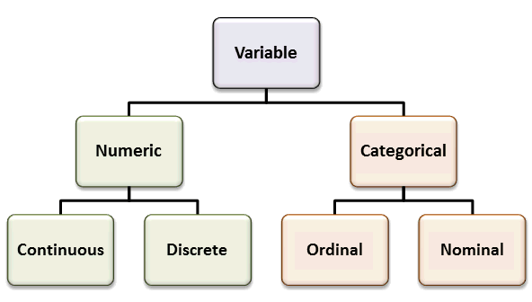

Slide 7
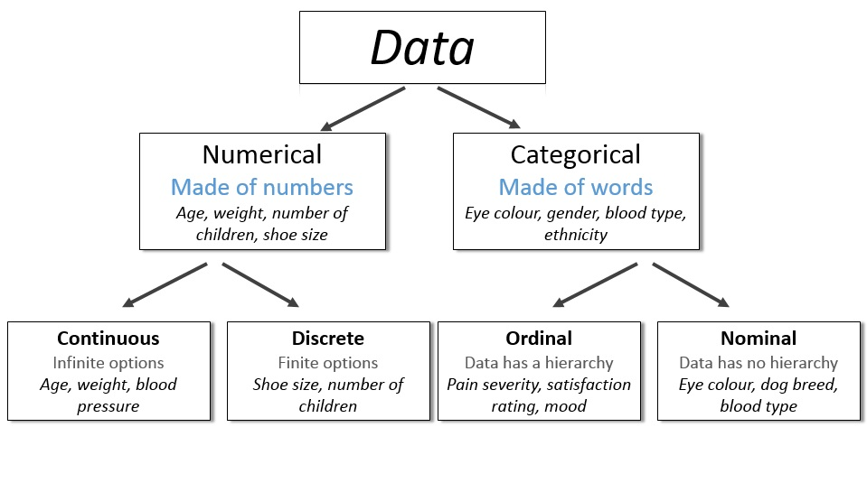

Slide 8
Numerical
Numerical values or observations can be measured and placed in ascending or descending order. Scatter plots and line graphs are used to graph numerical data.
DISCRETE values or observations are counted as distinct and separate and can only
take particular values. They cannot be measured, for instance number of threads
in a sheet, number of stars given for an energy rating.
CONTINUOUS data represents measurements and therefore their values cannot be counted, but they can be measured. Values or observations may take on any value within a finite or infinite interval. Examples: height, time and temperature.

Slide 9
Categorical data
Categorical data can be sorted into groups or categories. Bar charts, histograms and pie graphs are used to graph categorical data.
NOMINAL values represent discrete units and are used to label variables
that have no quantitative value. Just think of them as “labels”.
You can count but not order or measure nominal data.
Examples: sex, eye color.
ORDINAL values or observations that can be ranked (put in order) or have a rating scale attached.
You can count and order, but not measure ordinal data.
Example: house numbers and swimming level.

Slide 10
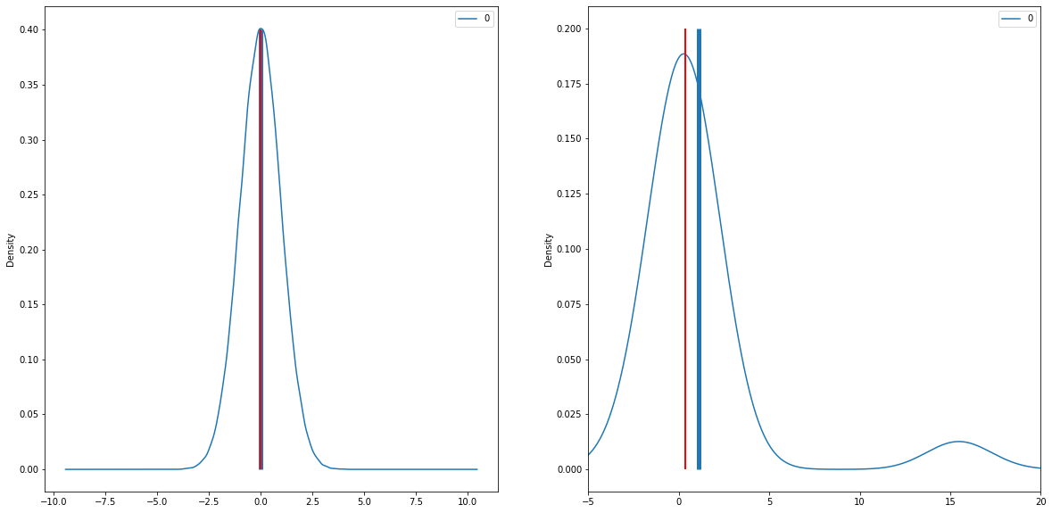
Measure of Central Tendency
Mean: average, sum of observations divided by number of observations
Median: observation that falls in the middle of ordered sample, splits sample into 2 when ordered.
Mode: most frequent value

Slide 11
Measure of Position
point at which a given percentage of data fall below or above that point
Percentile: the p^{th} percentile is the point such that p% of the observations fall below or at that point and (100-p%) fall above it. The median is the 50th percentile
Lower (upper) quartile: 25th (75th) percentile
Outlier: data point that differs significantly from other observations. Not all outliers are errors!

Slide 12
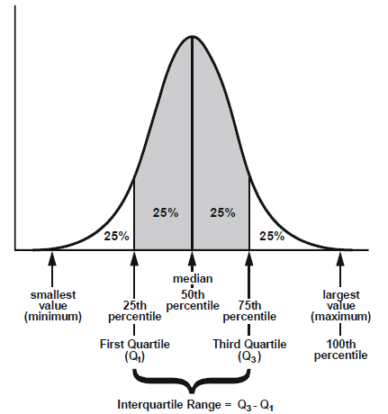

Slide 13
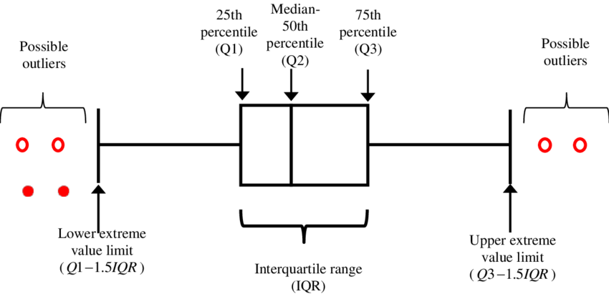

Slide 14
Measure of Dispersion
Range: difference between largest and smallest observation
Standard Deviation: deviation of data from the mean value
Variance: measure of how far observations are spread out from their mean value.
Calculated as square of standard deviation

Slide 15
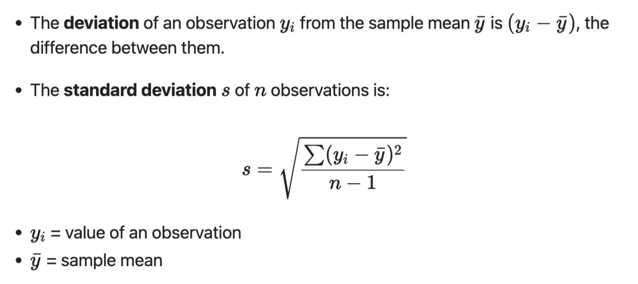
Standard Deviation

Slide 16
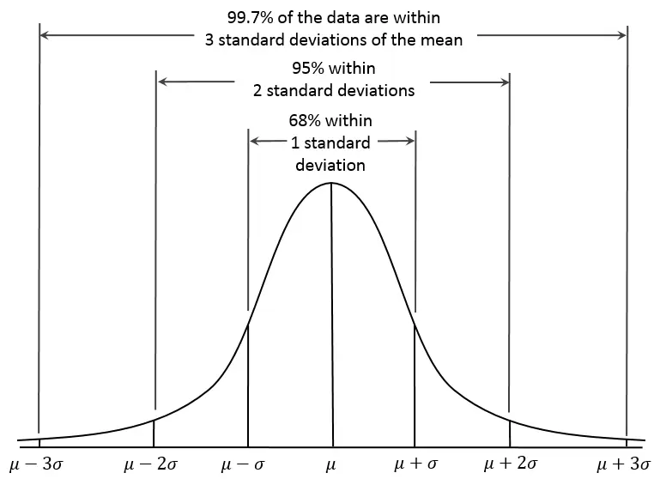

Slide 17
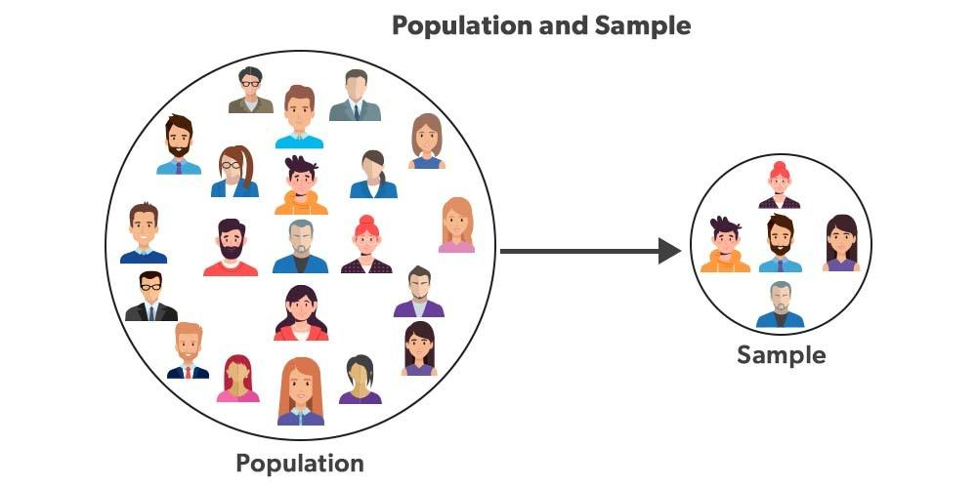

Population & Sample
Population
The entire group that we want to infer. (not necessarily a group of people)
Sample:
Specific group of the population that will be collected data from.

Slide 18

Representative samples
Is the sample representative?
What is the probability that the sample is equal to the population
If x% of a sample of people have Y, it does NOT automatically mean that x% of people have Y.
A sample is representative if the variation is the same in the
sample as in the population.
How do you measure variation?
  Mean
  Deviation from mean

Slide 19
From data to wisdom
Information consists of data, but data is not necessarily information.
Also, wisdom is knowledge, which in turn is information, which in turn is data, however knowledge is not necessarily wisdom.
Wisdom is a subset of knowledge, which is a subset of information, which is a subset of data.

Slide 20
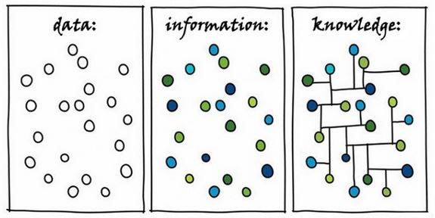
Data: information such as numbers, text, images and sounds, in a form that is suitable for storage or processing by a computer, used as a basis for making calculations or drawing conclusions.
Information: data that has been organized and presented in a systematic fashion to clarify the underlying meaning.
Knowledge: awareness or possession of information, facts, ideas, truths, or principles, understanding gained through experience or study.

Slide 21
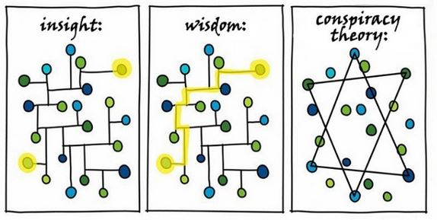
Insight: understanding of relationships that sheds light on or helps to solve a problem.
Wisdom: knowledge and experience needed to make sensible decisions and judgments.
Conspiracy Theory: a theory that rejects the standard explanation for an event and instead credits a covert group or organization with carrying out a secret plot.

Slide 22

WE DID IT!

